Slide 1
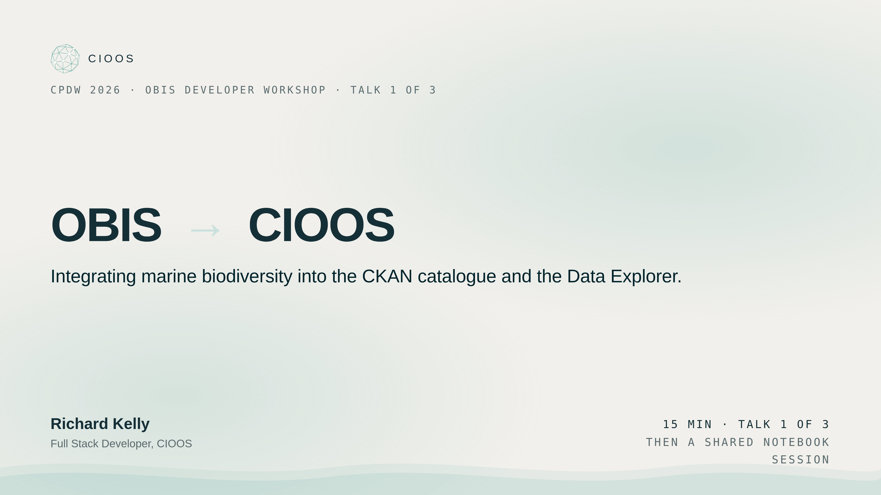
Notes:
Welcome. Quick orientation. This is the first of three short talks in the OBIS Developer Workshop here at CPDW 2026. Mine is on how OBIS — the global marine biodiversity database — now flows into CIOOS, specifically into our metadata catalogue powered by CKAN and into the CIOOS Data Explorer. After mine, Simon and the team cover programmatic publishing to OBIS via the IPT, and Darwin Core validation with pyobistools. Once all three talks wrap, we all jump into the hands-on notebooks together — every host helping out. By the end of this talk you'll know what the integration looks like, what users get out of it, and how the pipelines fit together.

Slide 2
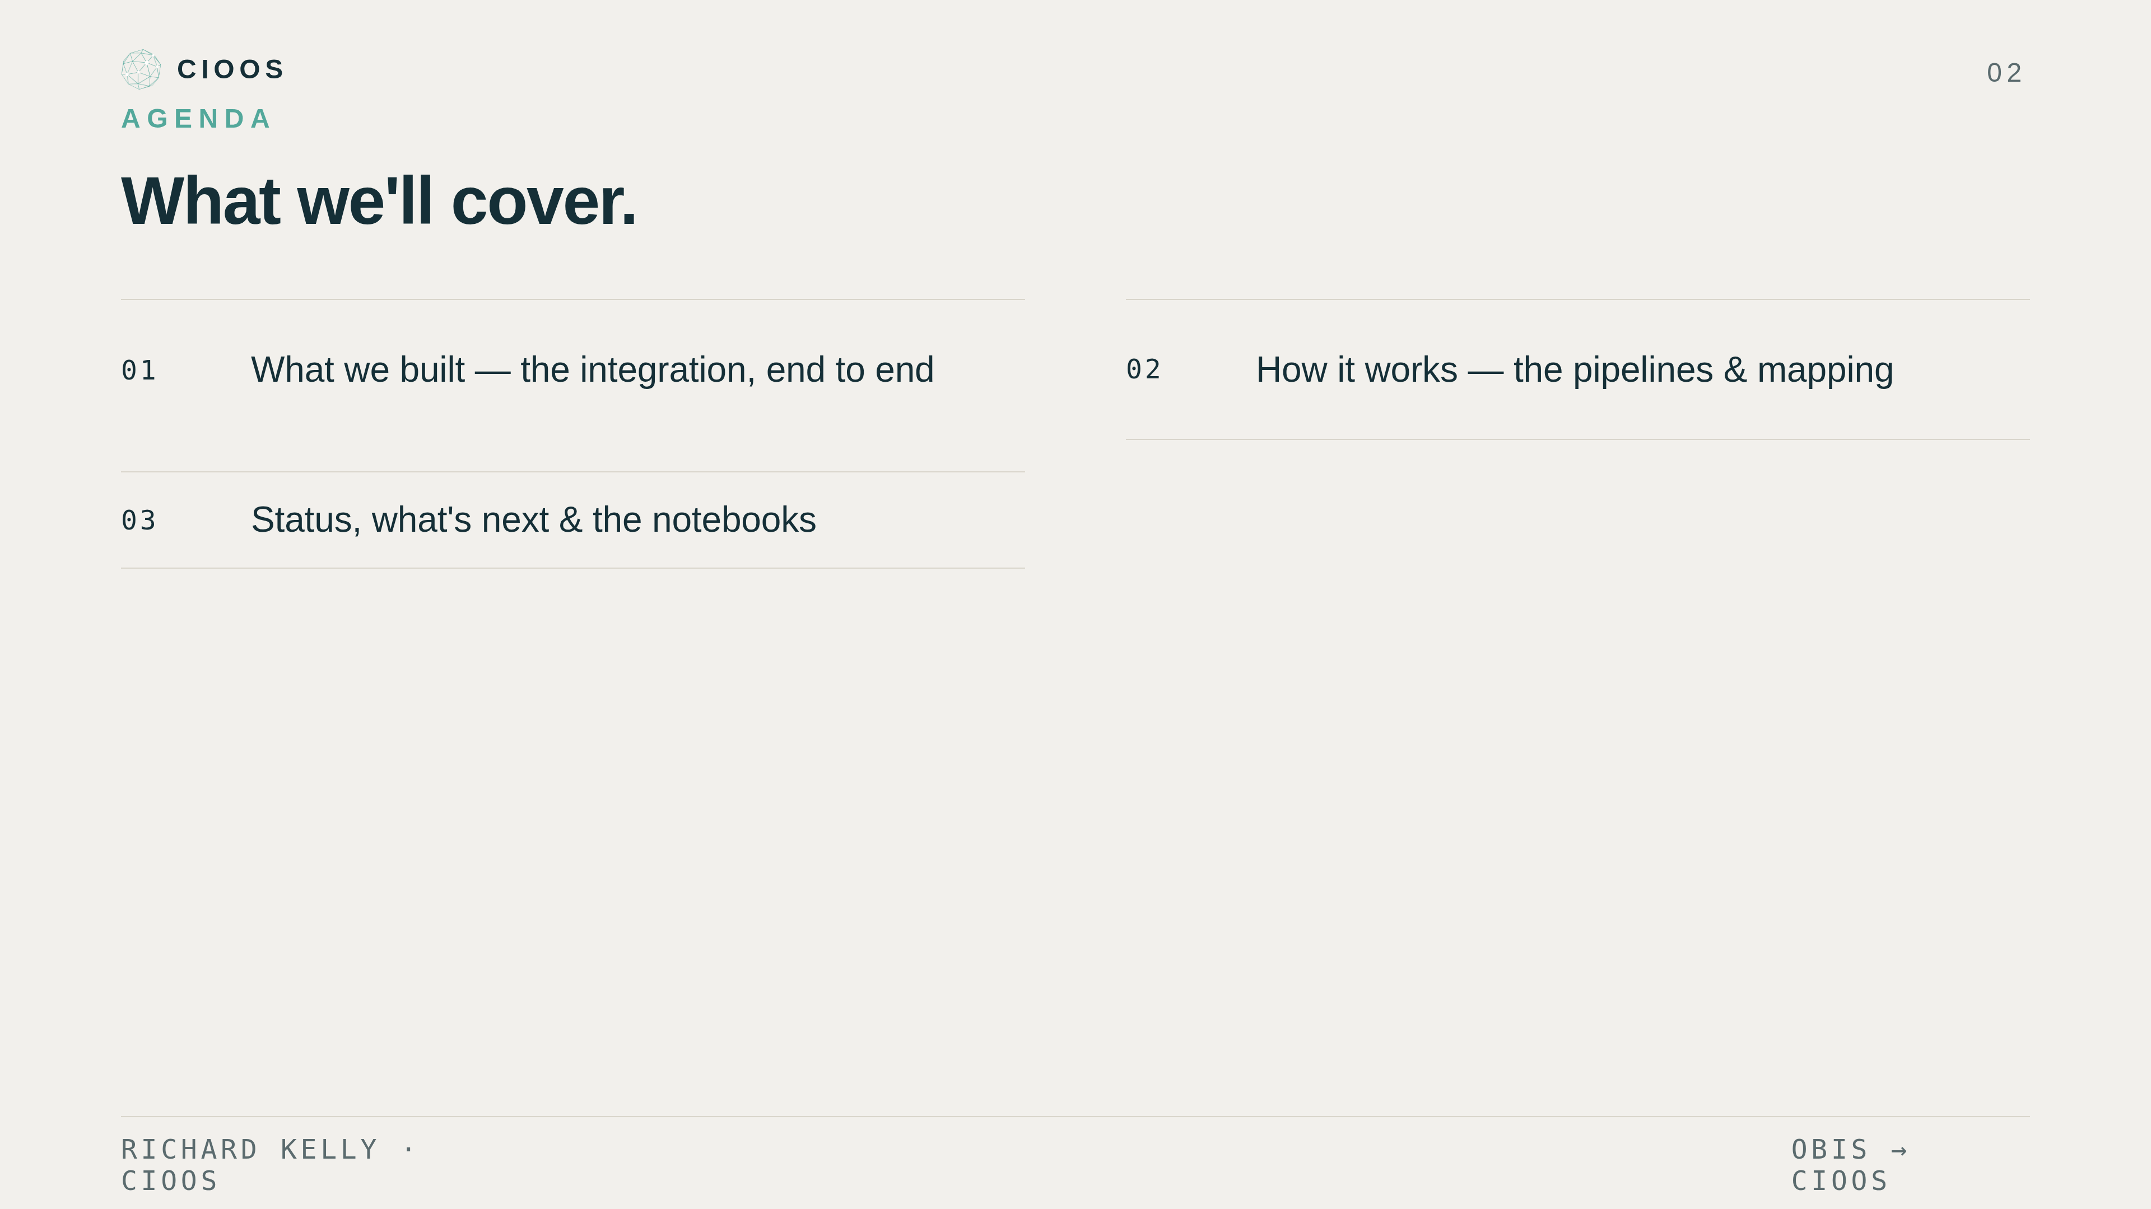
Notes:
Three parts to the talk. First, what we built — context on OBIS, then what the integration looks like from a user's seat. Second, how it works — the two pipelines that move data from OBIS into CIOOS, and the EOV-derivation logic that took longest to get right. Third, status, lessons, and where this goes next. Then we open the notebooks.

Slide 3
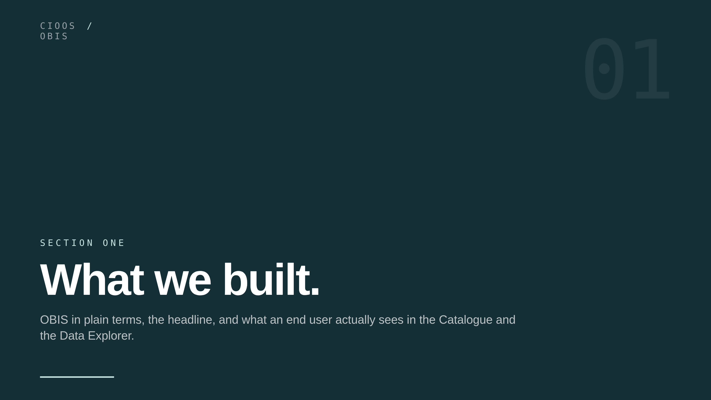
Notes:
Section one: what we built. Two pieces of context, then the punchline, then a tour of what an end user actually sees in the catalogue and the Data Explorer.

Slide 4
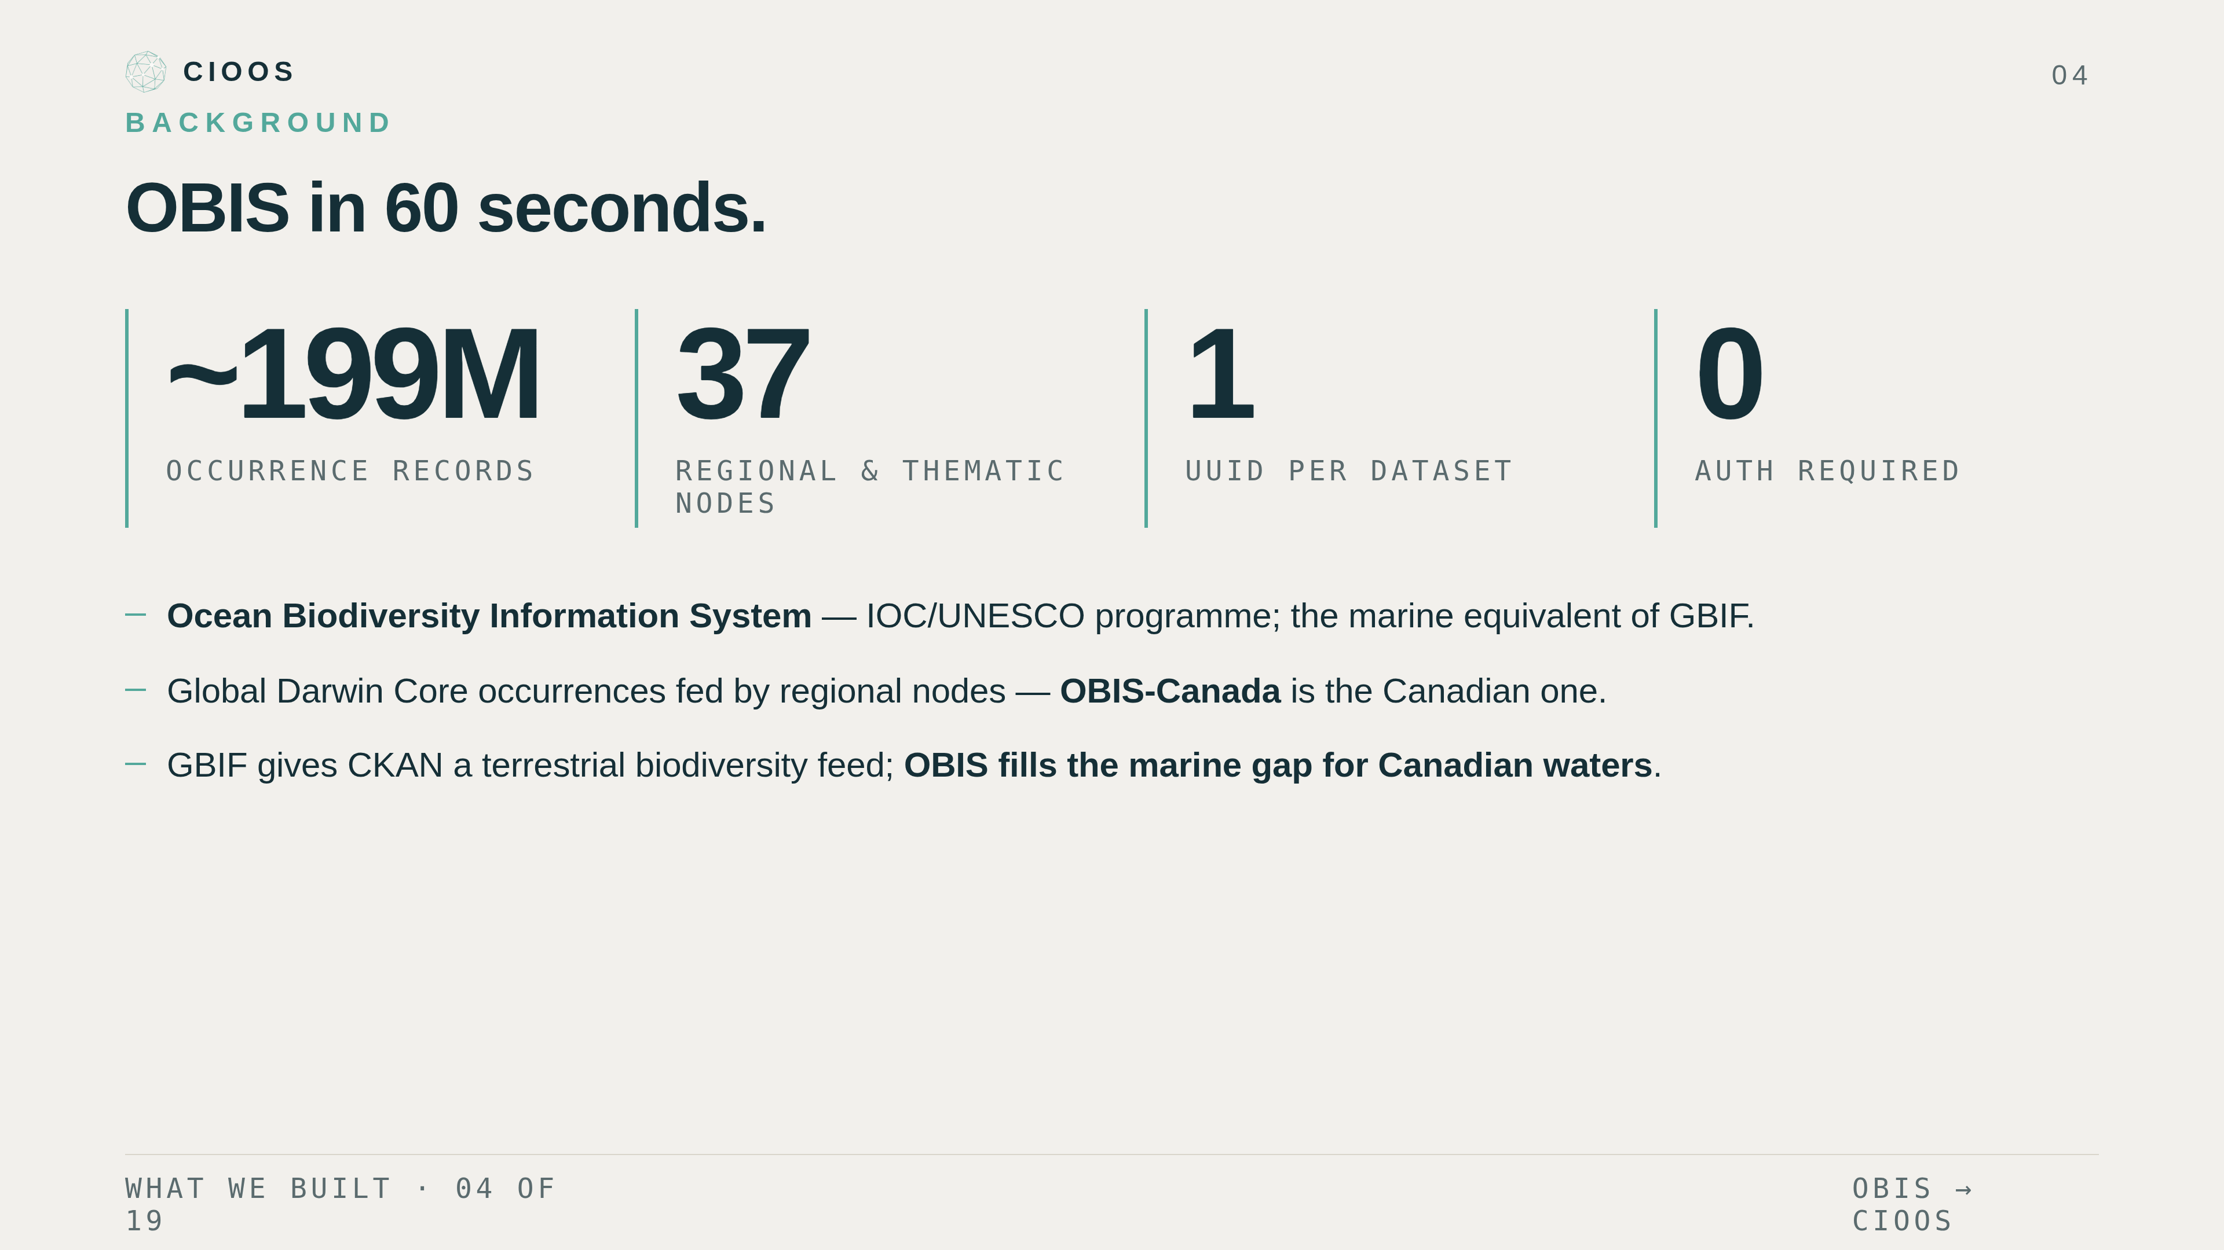
Notes:
OBIS — Ocean Biodiversity Information System. IOC-UNESCO programme; the marine GBIF. Around two hundred million Darwin-Core occurrence records, fed by thirty-seven regional and thematic nodes including OBIS-Canada. Three things to internalize. The catalogue is fully public — no auth, no token. Every dataset has a stable UUID; that UUID is the only key our pipelines need. And while GBIF gives CKAN a terrestrial biodiversity feed, OBIS is its marine equivalent for Canadian waters — that's the gap we're filling.

Slide 5
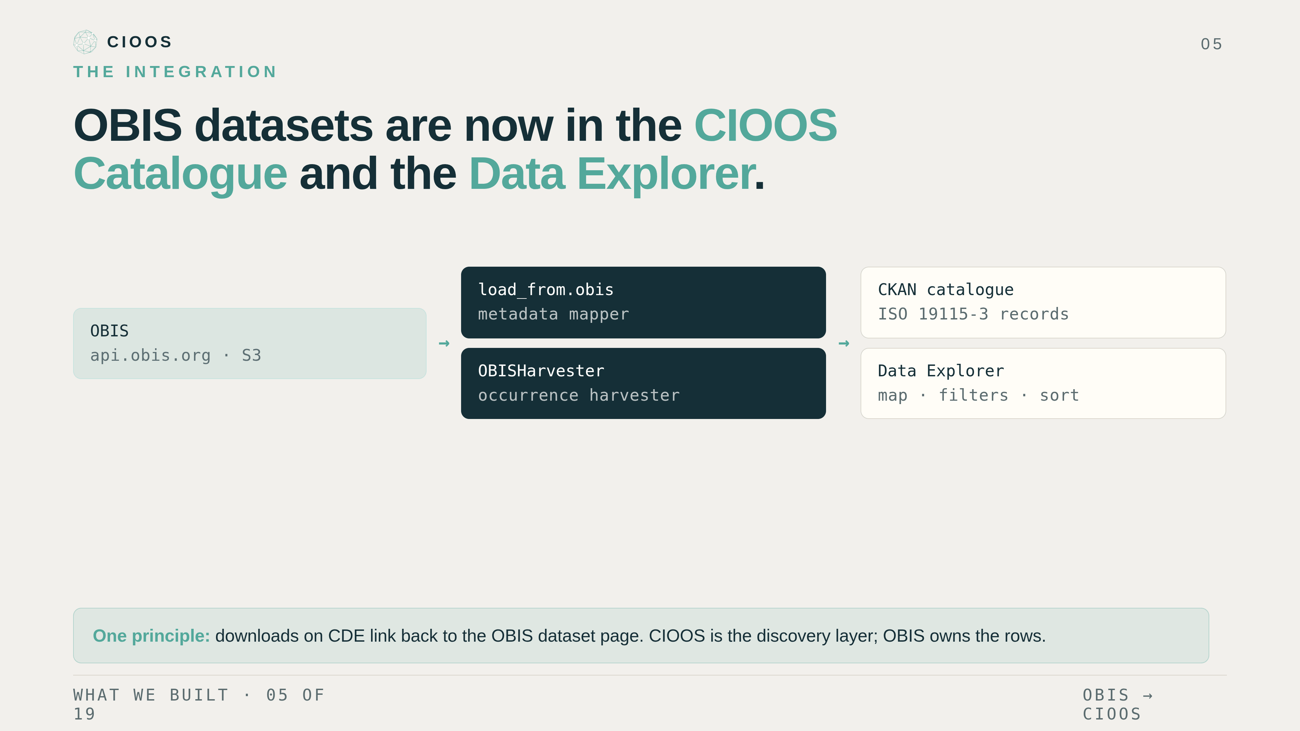
Notes:
Here's the headline. As of this release, OBIS biodiversity datasets are first-class citizens in both halves of CIOOS. They're discoverable as proper ISO-19115 records in the CKAN catalogue. And they're explorable on the Data Explorer with the same filters, sorts, and downloads as our ERDDAP datasets. Metadata flows one way: OBIS to CKAN at harvest time. Occurrence data flows the other way at run time: OBIS to the Data Explorer. And there's a feedback link — CKAN's curated EOV list flows back into the occurrence harvester to keep the two views consistent. Critical principle: downloads on CDE link out to the OBIS dataset page. We surface, we don't rehost.

Slide 6
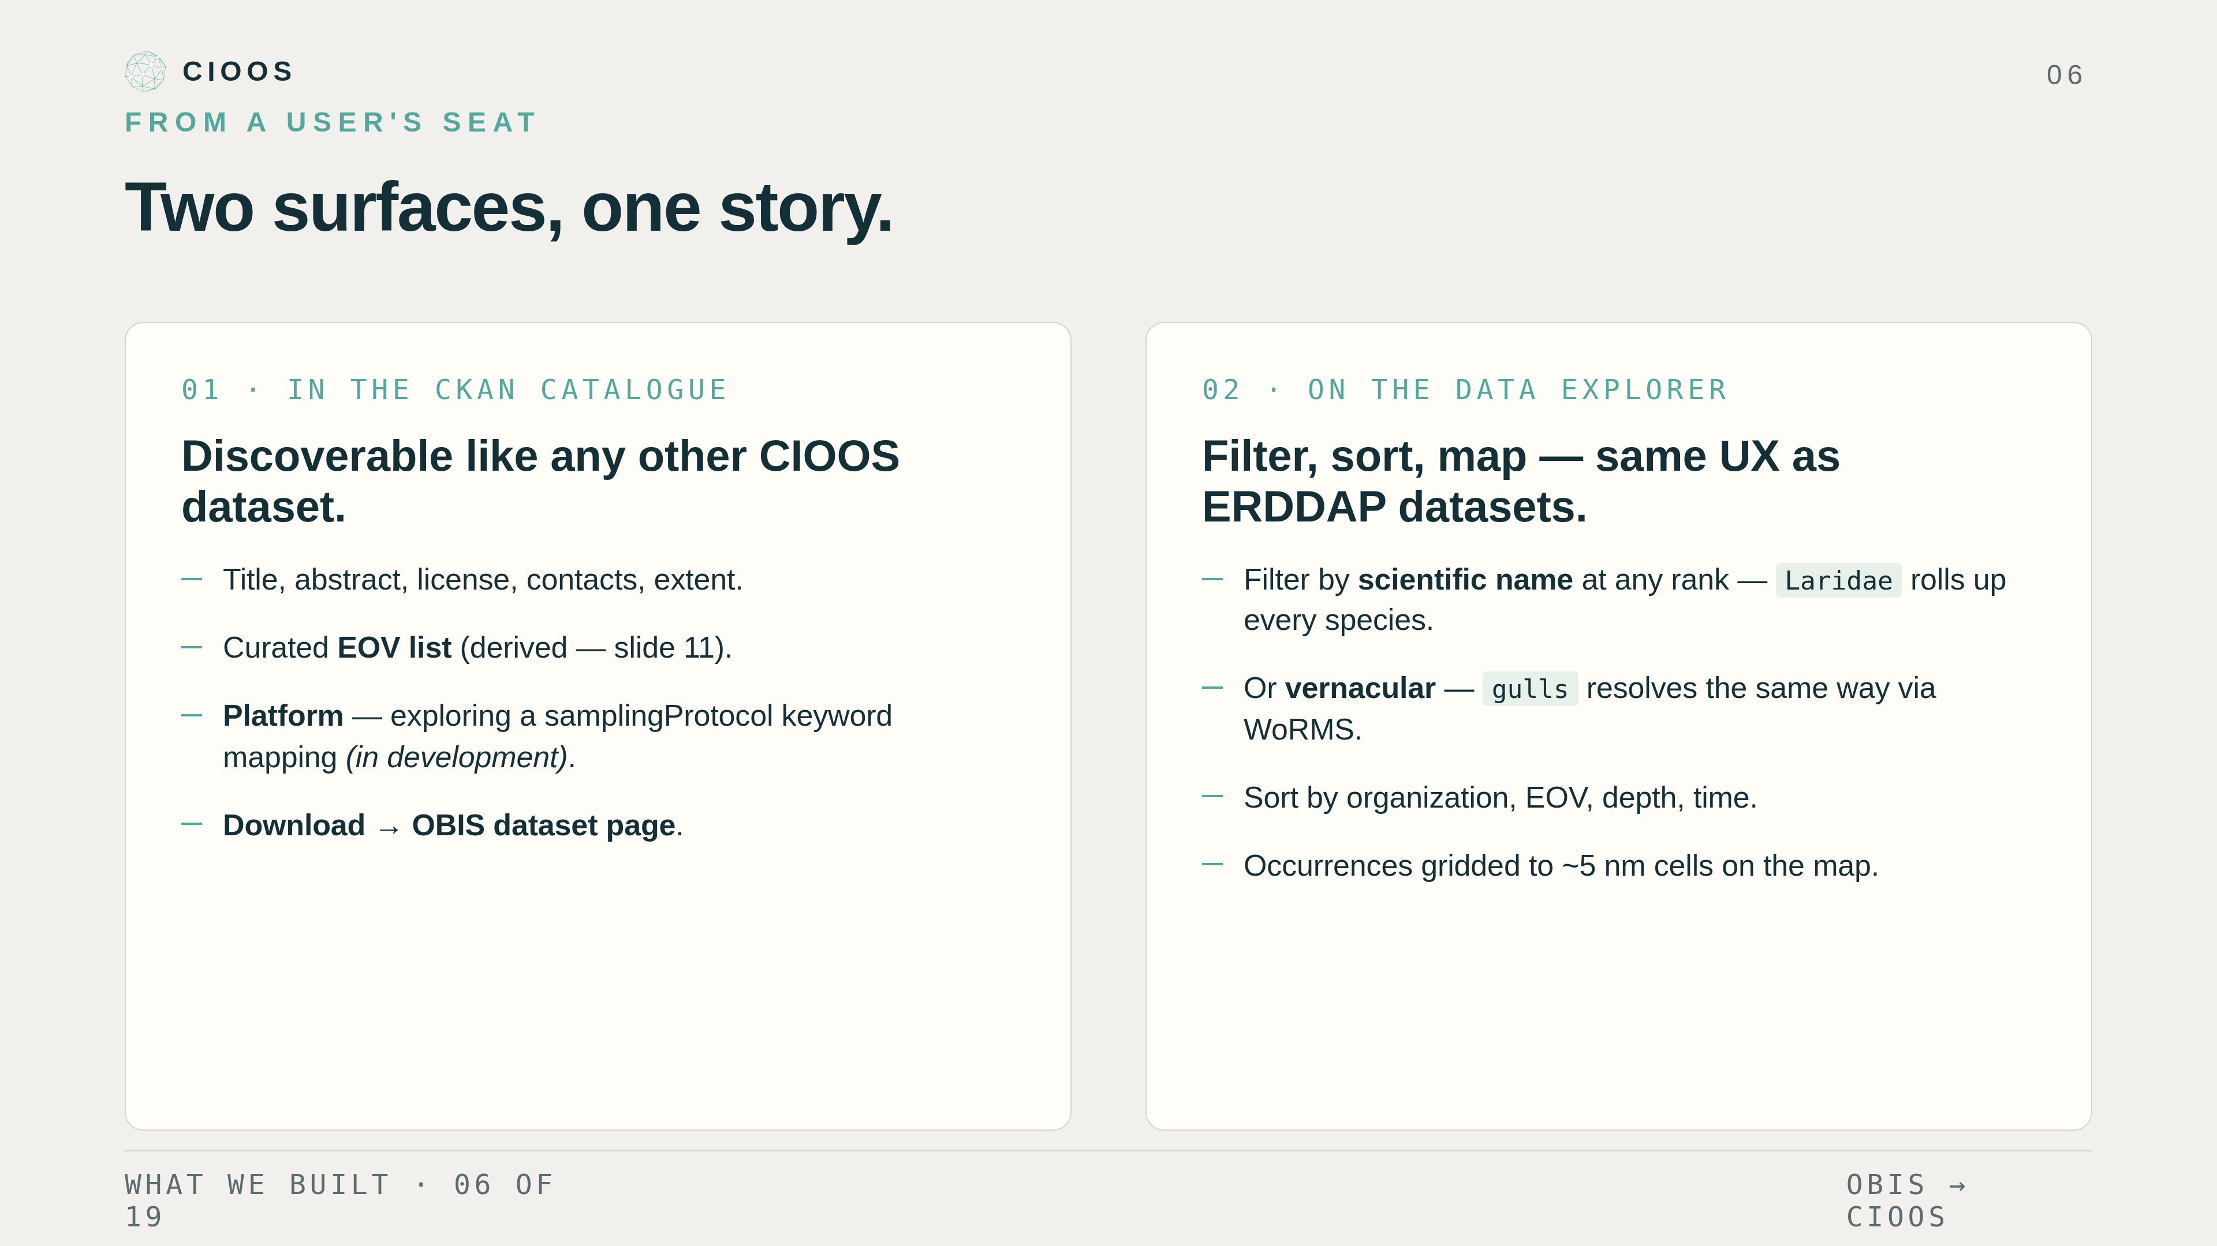
Notes:
Two surfaces, one story. On the left: in the CKAN catalogue, an OBIS dataset looks like any other CIOOS record. Title, abstract, license, contacts, spatial extent, the curated EOV list, and — still in development — a platform guess we're prototyping from samplingProtocol keywords. Download takes you back to OBIS. On the right: in the Data Explorer, occurrences render as gridded points on the map and you get three new filter axes — filter by scientific name, like Calanus finmarchicus; filter by vernacular name, like northern krill; and sort by EOV like every other CDE dataset. Same UX, new dataset class.

Slide 7
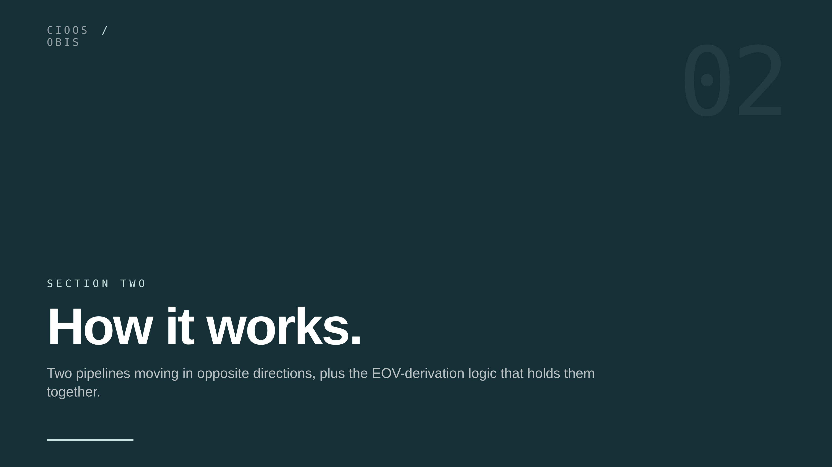
Notes:
Section two: how it works. Two pipelines, an architecture page to anchor them, then a slide each on the CKAN side, the EOV-derivation logic, and the CDE side. Five minutes; let's go.

Slide 8
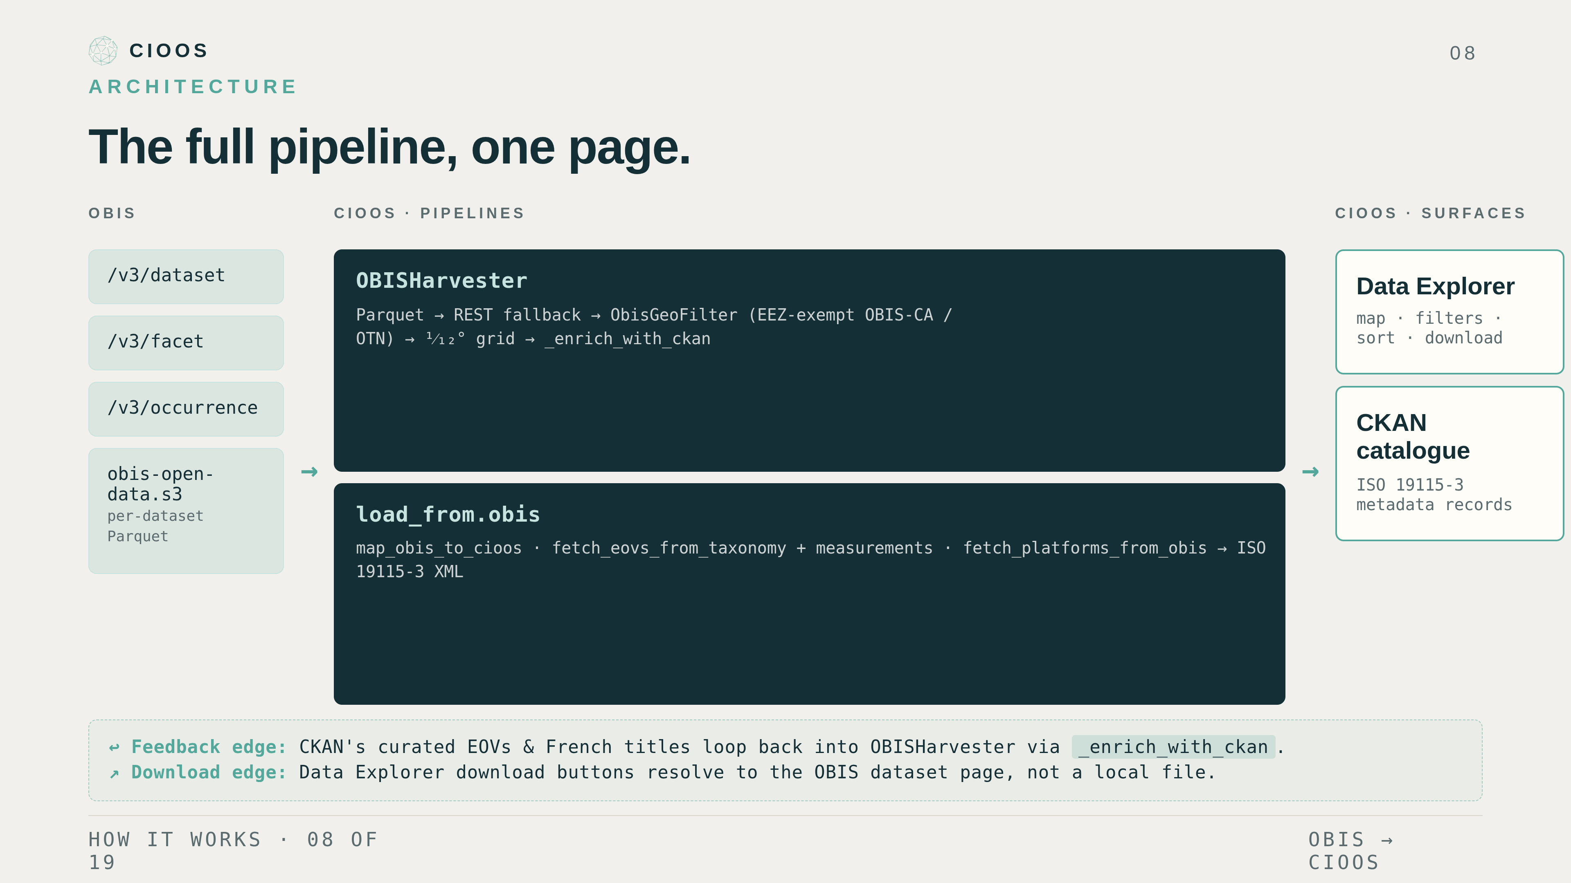
Notes:
Here is the full system on one page. Left column — three OBIS endpoints we use, plus the per-dataset Parquet files on S3. Middle column — our two pipelines. The top pipeline, OBISHarvester, pulls occurrence rows for the Data Explorer; the bottom pipeline, load_from.obis, pulls dataset payloads and maps them to CIOOS metadata for CKAN. Right column — the two CIOOS surfaces the user sees. Dashed feedback line at the bottom: CKAN's curated EOVs and French titles loop back into the harvester so the two views stay aligned. Two outbound arrows from the user-facing column show downloads going back to OBIS rather than to a local file.

Slide 9
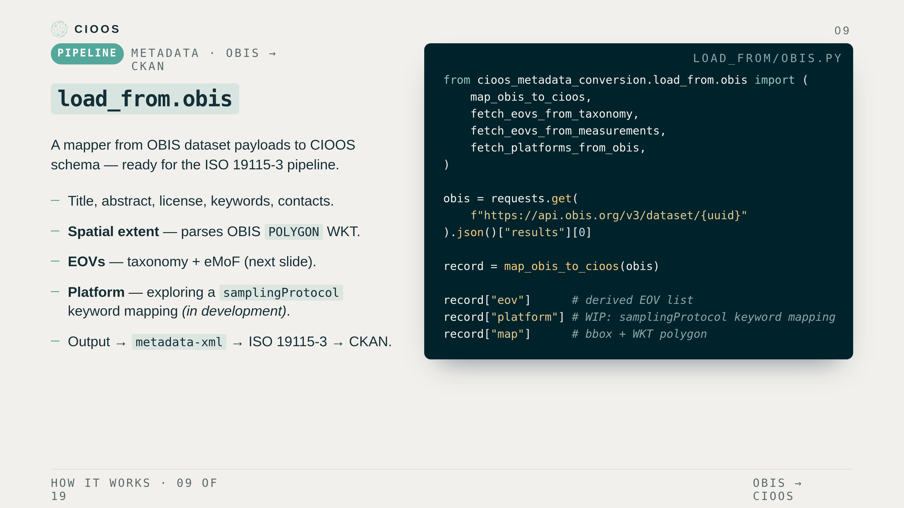
Notes:
CKAN side, in detail. load_from.obis is a function in cioos-metadata-conversion. Input: an OBIS dataset payload as JSON. Output: a CIOOS-shaped dictionary that the metadata-xml tool turns into ISO 19115-3, and CKAN ingests. Most fields are straight mappings — I'll show the field-by-field correspondence on the next slide. The two that need real work are EOVs — the slide after that — and platform, which we're still prototyping from the samplingProtocol free-text; we emit conservatively and set noPlatform when nothing matches.

Slide 10
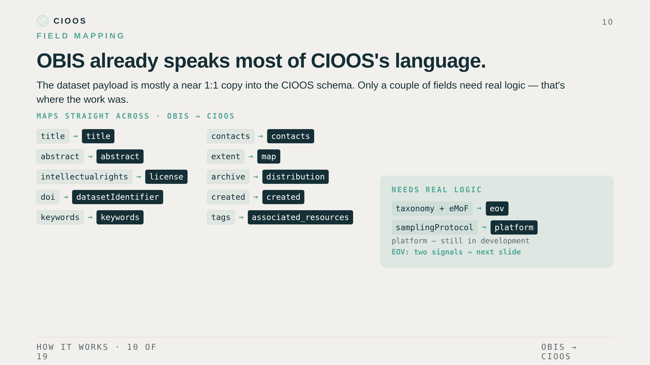
Notes:
Field mapping. The reason this was tractable is that OBIS metadata already lines up with most of the CIOOS schema. Title, abstract, license, keywords, contacts, the spatial extent from OBIS's POLYGON WKT, the dataset and archive URLs, the dates — all near one-to-one copies into the CIOOS record. Two fields are the exception and need real logic: the EOV list, which we derive from taxonomy and measurements — that's the next slide — and platform, which we're prototyping from samplingProtocol keywords and is still in development.

Slide 11
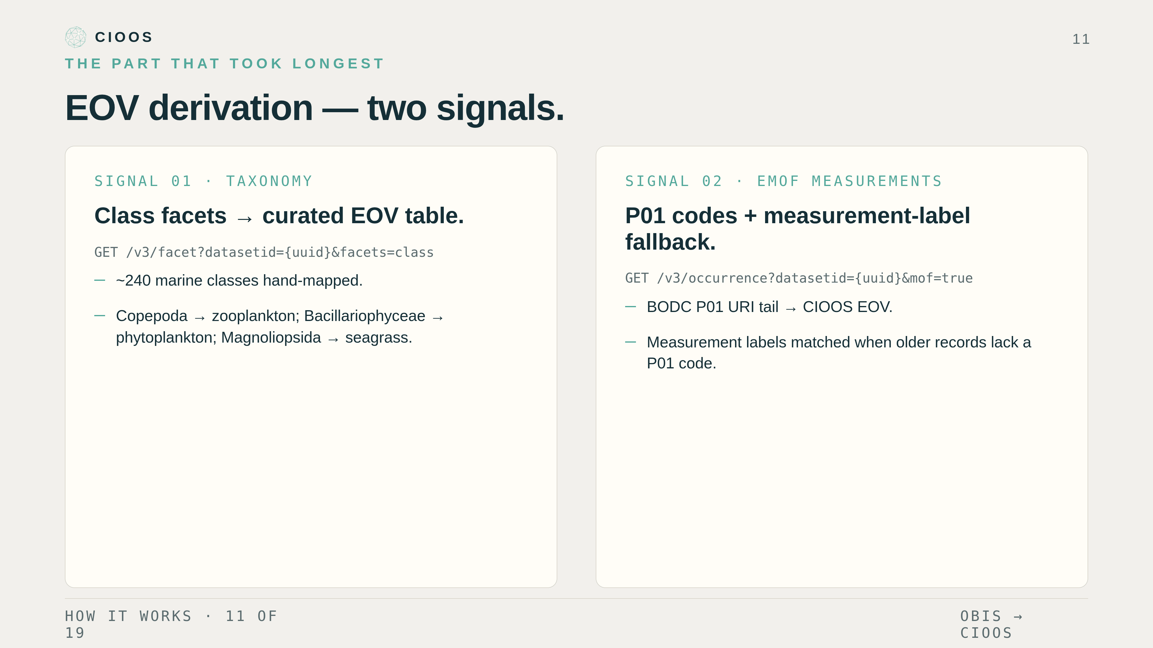
Notes:
EOV derivation. This is the part that took the longest to get right. Two independent signals. Signal one — taxonomy. We call the OBIS facet endpoint for the dataset's class breakdown and map each class to an EOV using a hand-curated table of about two hundred and forty marine classes. Copepods become zooplankton. Diatoms become phytoplankton. Magnoliopsida becomes seagrass. Signal two — eMoF measurements. We sample occurrences with mof=true, read the P01 code from each measurementTypeID, and map to EOV using a parameter table — plus a fallback that matches the measurement labels for older records. Both signals are noisy, so we apply some filtering to clean them up, then union the two and write the result into the CKAN record.

Slide 12
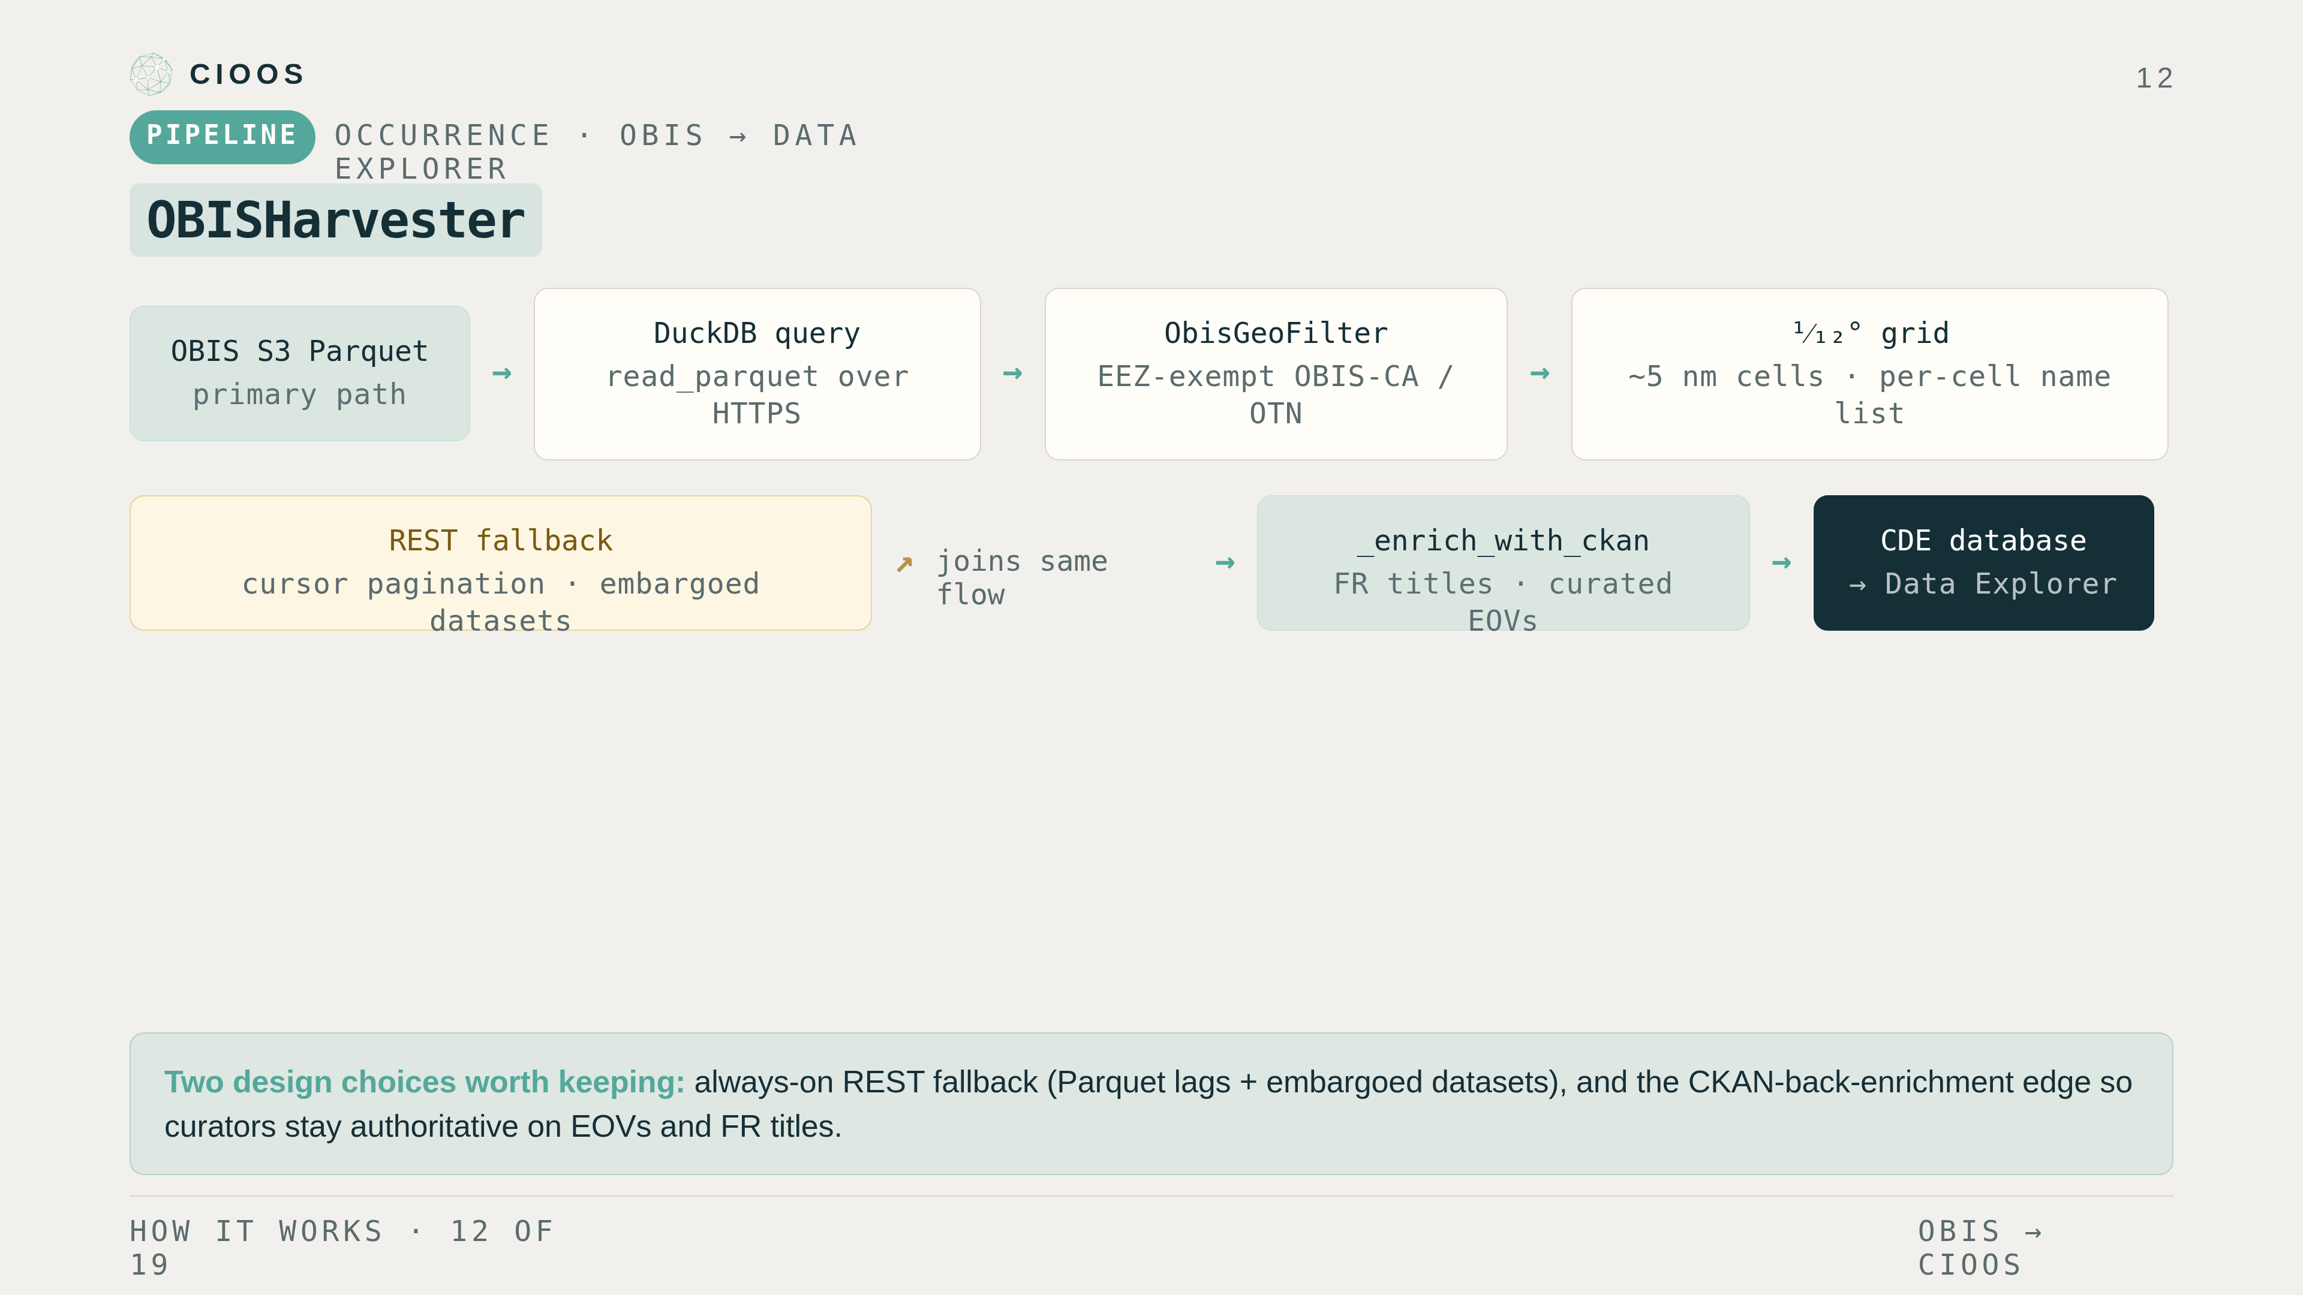
Notes:
CDE side. OBISHarvester is the entry point — it processes a configurable list of dataset UUIDs and emits the per-cell rows the Data Explorer database wants. Primary path: per-dataset Parquet on S3, queried in place with DuckDB. If Parquet four-oh-fours we fall back to the REST API with cursor pagination. Records get filtered to Canadian waters by the ObisGeoFilter — but OBIS-Canada and OTN datasets are exempt and pass through unfiltered, because they're already curated for Canadian relevance. We snap to a one-twelfth-degree grid — roughly five nautical miles — so the map isn't trying to render a hundred million points. Finally _enrich_with_ckan joins the dataset rows against the CKAN catalogue for French titles and the curated EOVs we built upstream. That's the feedback edge from the architecture slide.

Slide 13
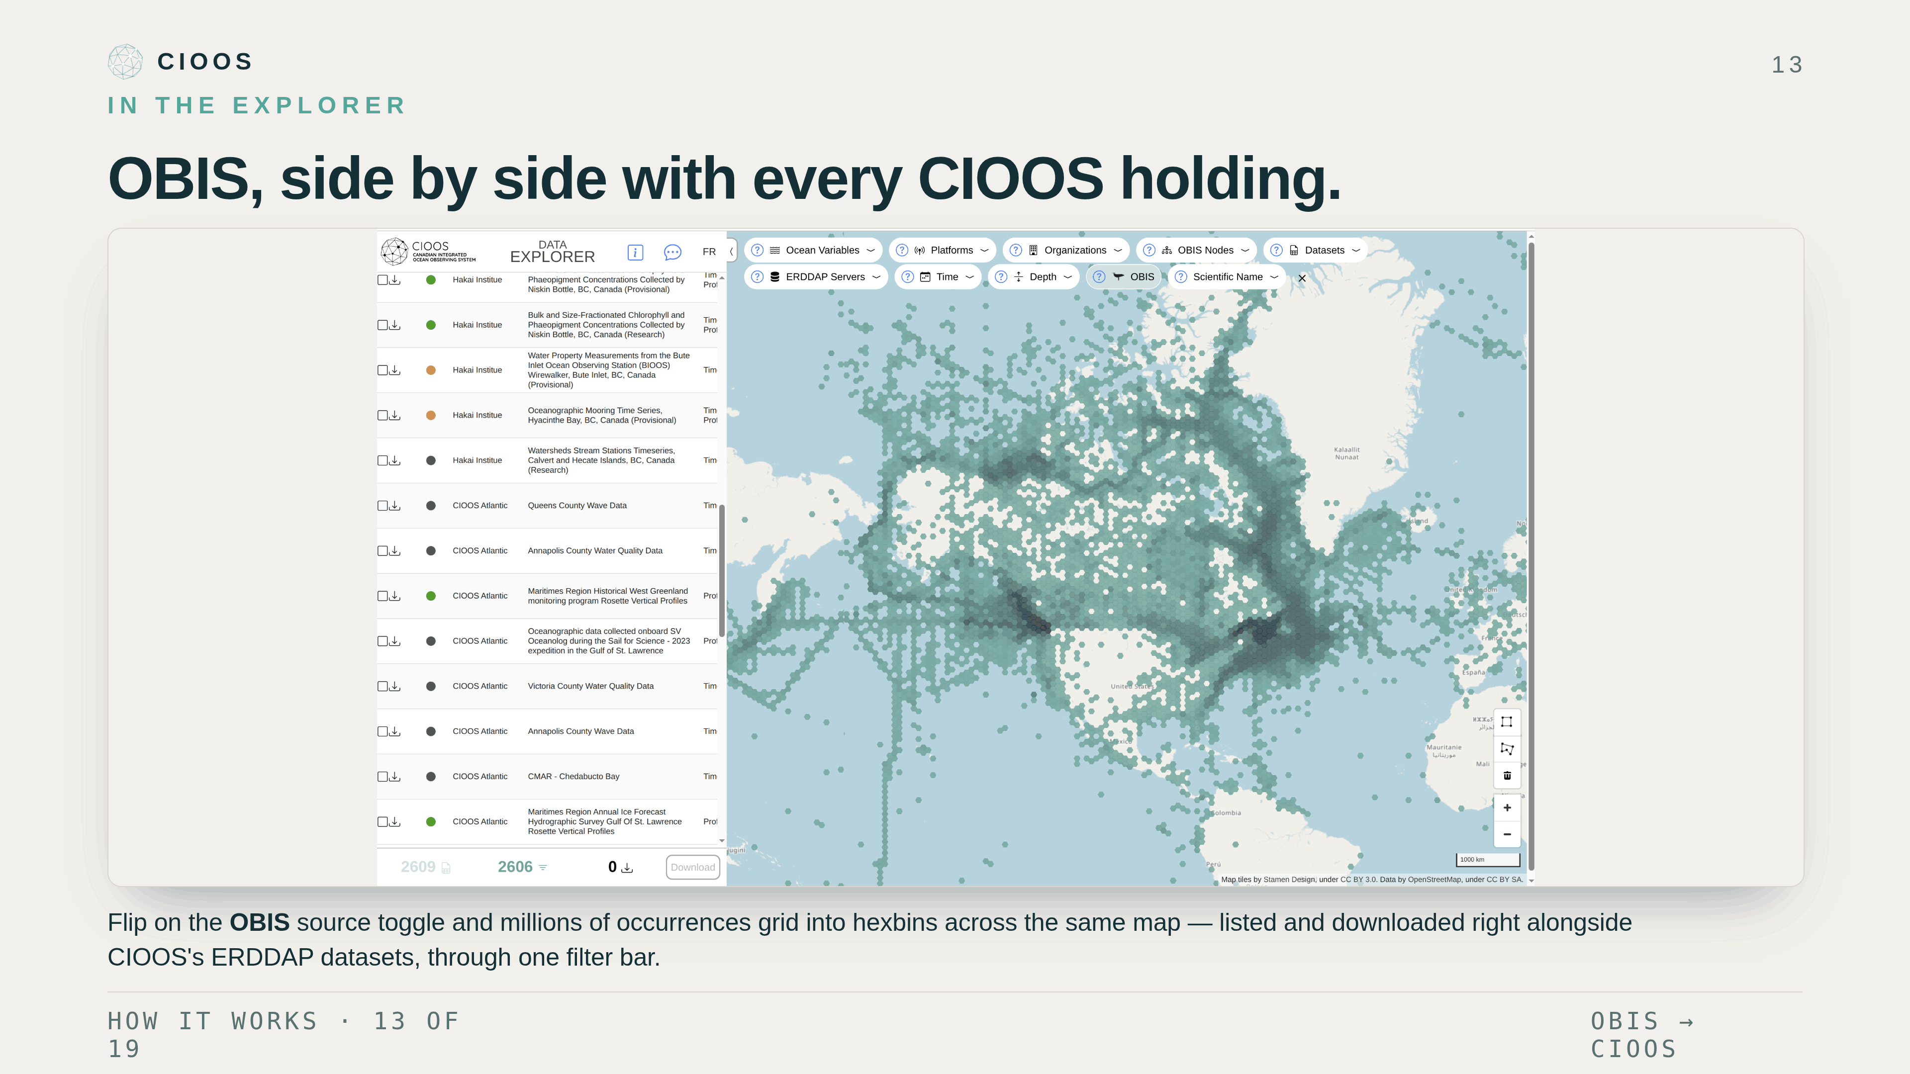
Notes:
And here's the payoff on a real screen. This is the Data Explorer with the OBIS source toggle flipped on — every OBIS occurrence in Canadian waters gridded into hexbins, the darker cells being denser. The thing to notice is that it's not a separate OBIS viewer: those occurrences sit in the very same dataset list, right next to Hakai, CIOOS Atlantic, and all our other ERDDAP holdings. Same filter bar across the top, same download cart at the bottom. One map, one workflow — OBIS biodiversity and CIOOS observations together.

Slide 14
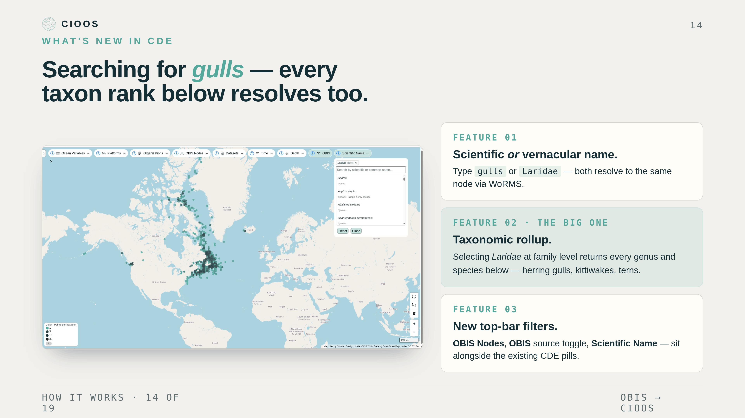
Notes:
What this gets us in the Data Explorer. Here's a real screenshot — someone searching for gulls. Three things to notice. First, the search resolved gulls to Laridae through WoRMS, so users don't have to know the Latin. Either direction works — type the vernacular or the scientific name. Second, and this is the big one: the filter does a taxonomic rollup. Picking Laridae at the family level returns every record below it — every genus, every species, herring gulls, kittiwakes, the whole thing. That's why the map lights up the way it does. Users don't have to enumerate species; they can search at whatever taxonomic level matches their question. Third, the top filter bar has new pills — OBIS Nodes, an OBIS data-source toggle, Scientific Name — sitting alongside the existing Ocean Variables, Platforms, Organizations. Same hex symbology as ERDDAP, same EOV and org sort across both sources. And downloads link out to OBIS.

Slide 15
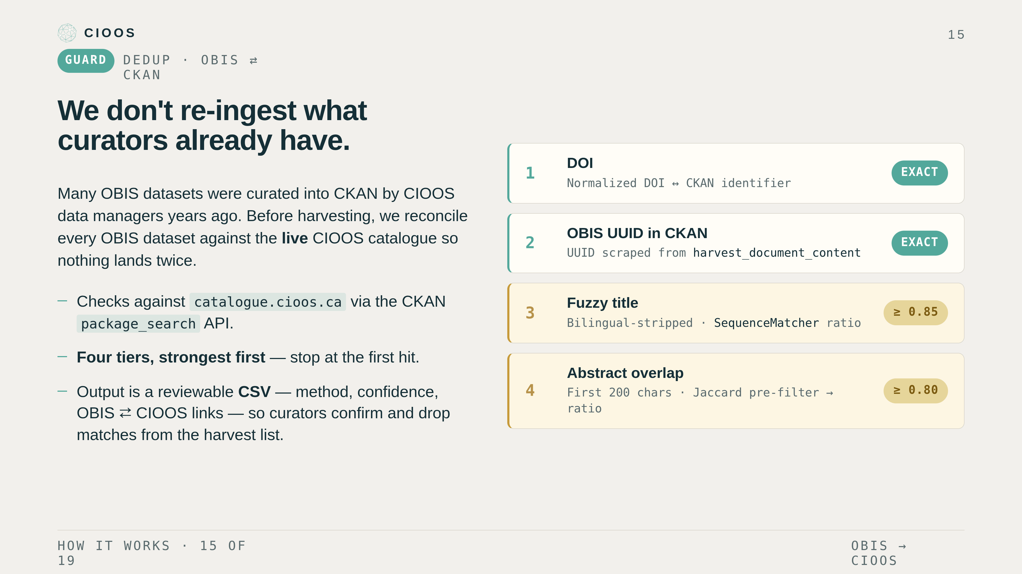
Notes:
Avoiding duplicates. A lot of OBIS datasets were already curated into our CKAN catalogue by CIOOS data managers — sometimes years ago — so before we auto-harvest anything we reconcile each OBIS dataset against the live CIOOS catalogue. The reconciliation script hits catalogue.cioos.ca through the CKAN package_search API and runs four match tiers, strongest first, stopping at the first hit. Tier one is an exact DOI match. Tier two is the OBIS UUID itself, scraped out of the CKAN record's harvest_document_content — both of those are exact, confidence one. Tiers three and four are fuzzy, for the many older records that have neither a DOI nor a harvested OBIS link: a bilingual-stripped fuzzy title match using SequenceMatcher at a 0.85 threshold, and an abstract-overlap match on the first 200 characters with a Jaccard word pre-filter then a 0.80 ratio. The output isn't an auto-delete — it's a reviewable CSV with the method, the confidence, and OBIS-to-CIOOS links side by side, so a curator confirms each match and drops the real duplicates from the harvest list. The point is we surface OBIS data without stepping on what data managers have already curated.

Slide 16
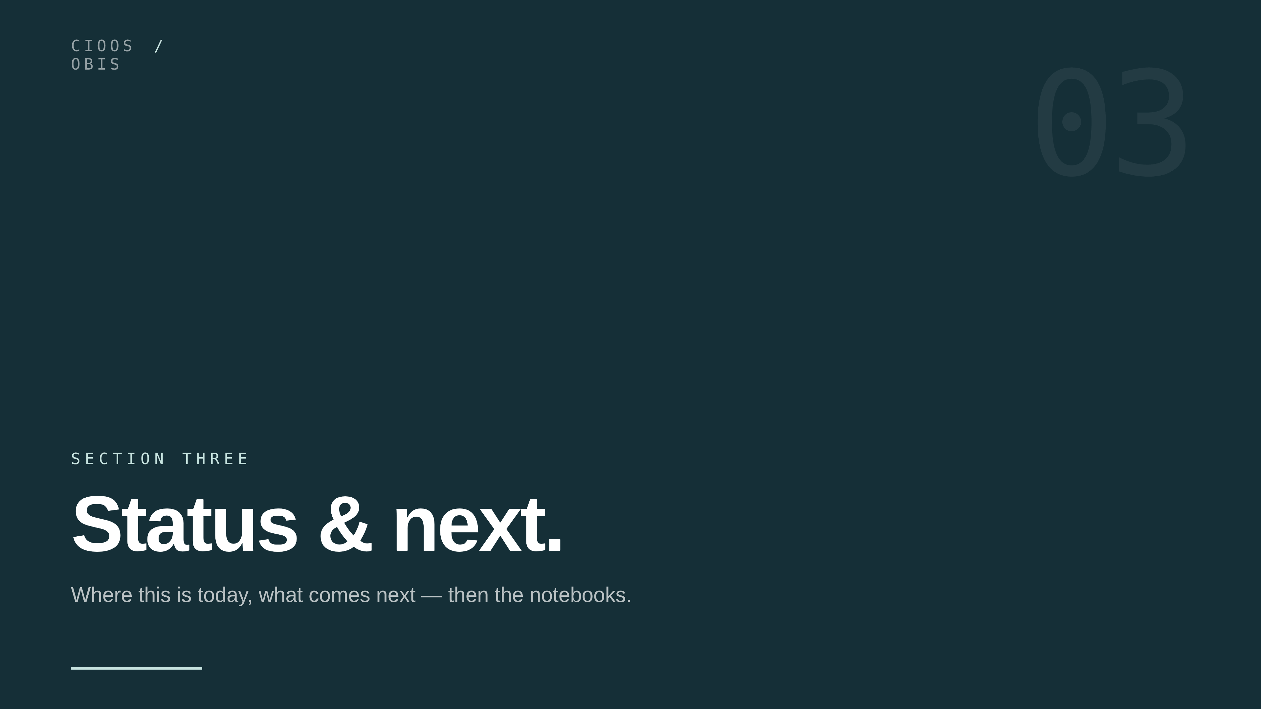
Notes:
Last section, briefly. Where this is today, then the notebooks.

Slide 17
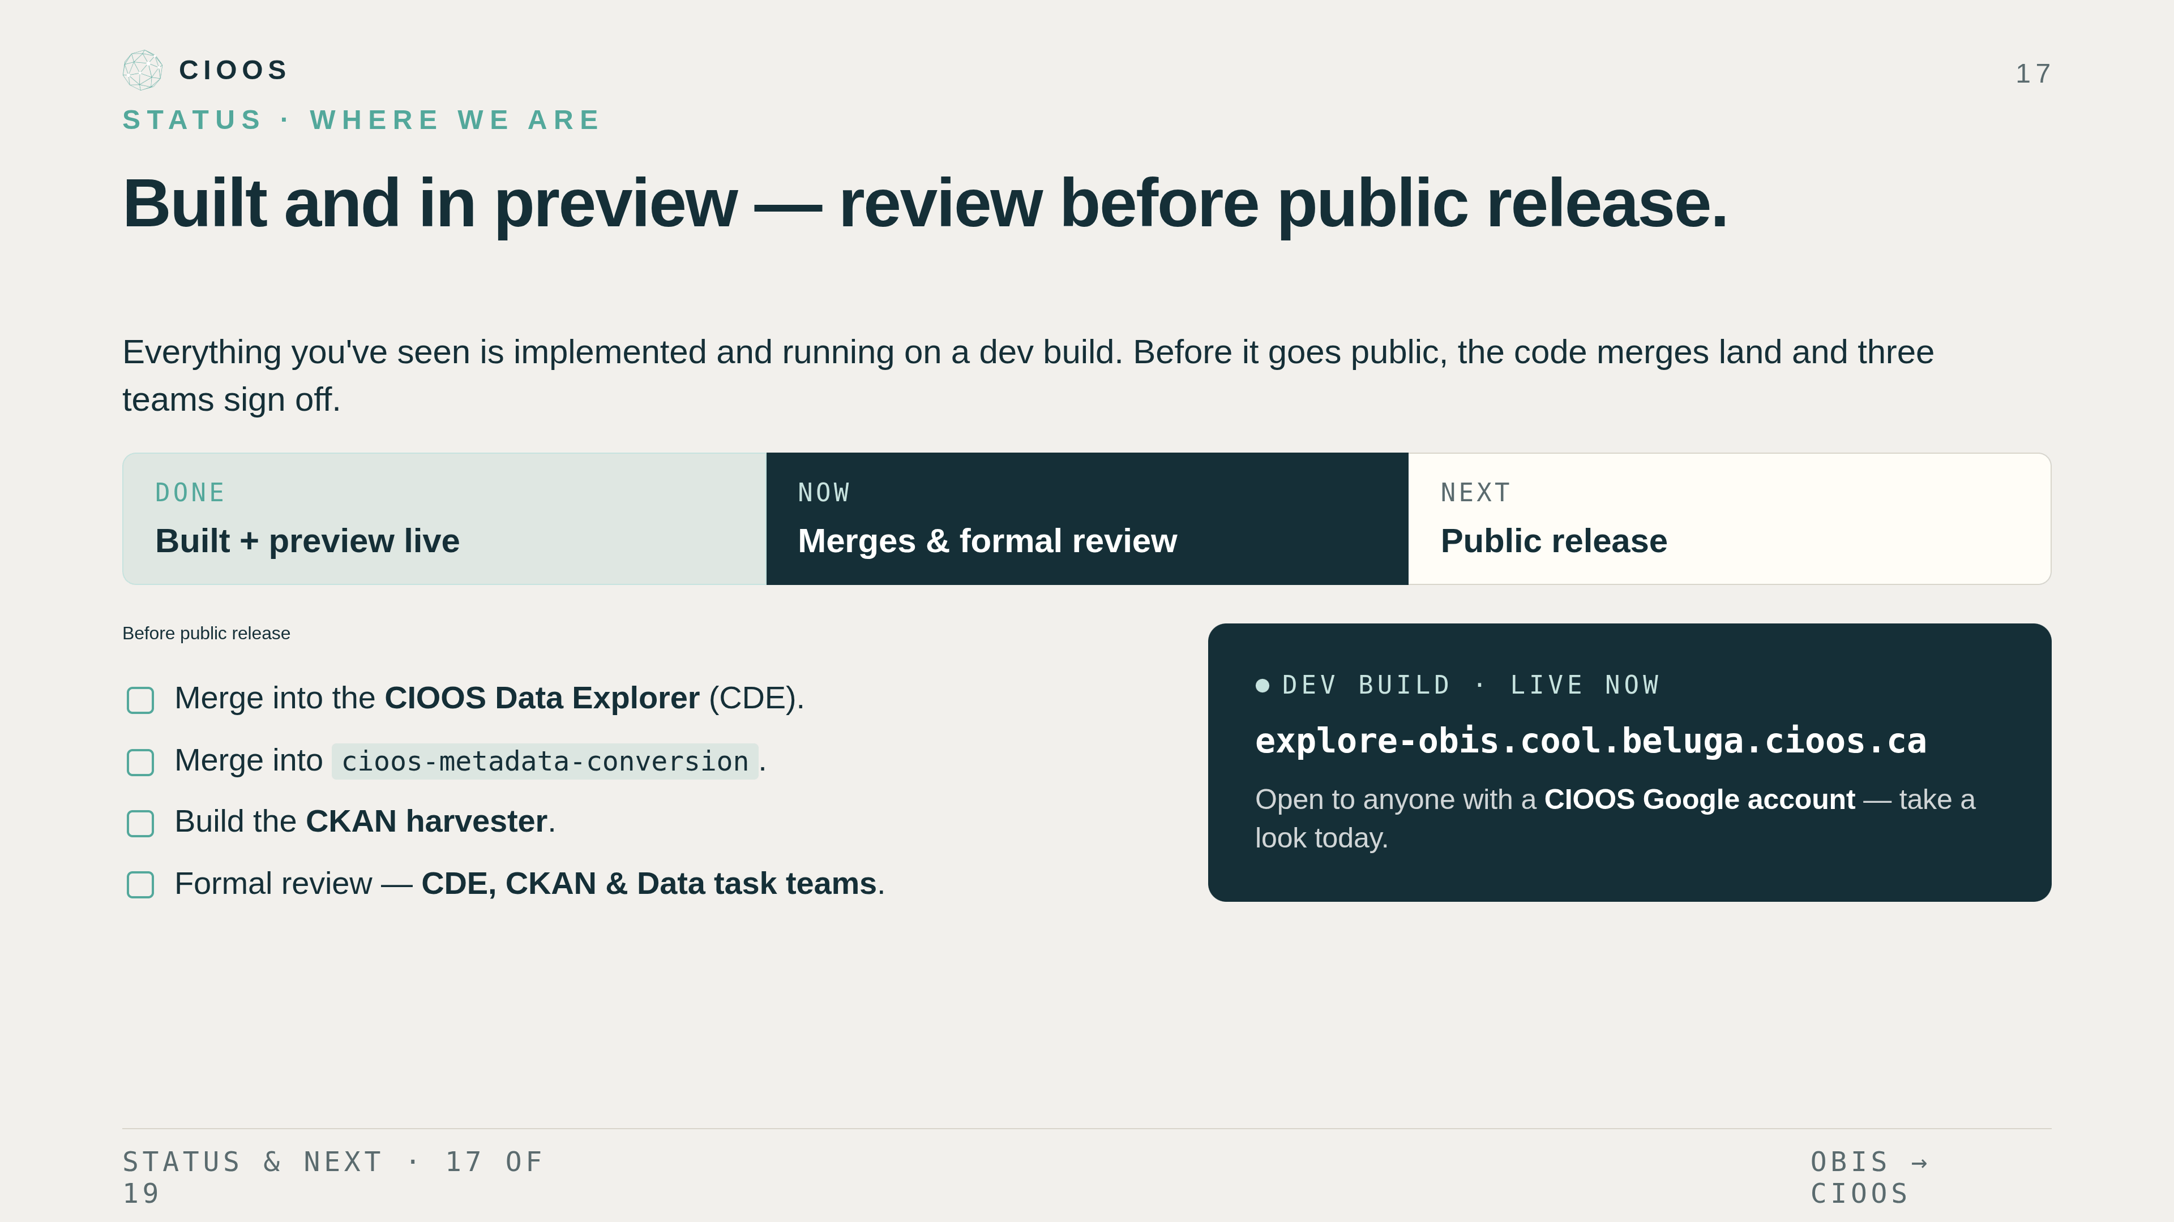
Notes:
Where we are. To be clear on status: everything I've shown is implemented and running — but it's a dev build, not a public release yet. There's a live preview at explore-obis dot cool dot beluga dot cioos dot ca; if you have a CIOOS Google account you can poke at it today. Before it goes public a few things have to land: the code has to merge into the CIOOS Data Explorer and into cioos-metadata-conversion, we need to build the CKAN harvester that runs the metadata side on a schedule, and then it goes through formal review with the CDE, CKAN, and Data task teams. Once those three sign off, we roll out an official release to the public.

Slide 18
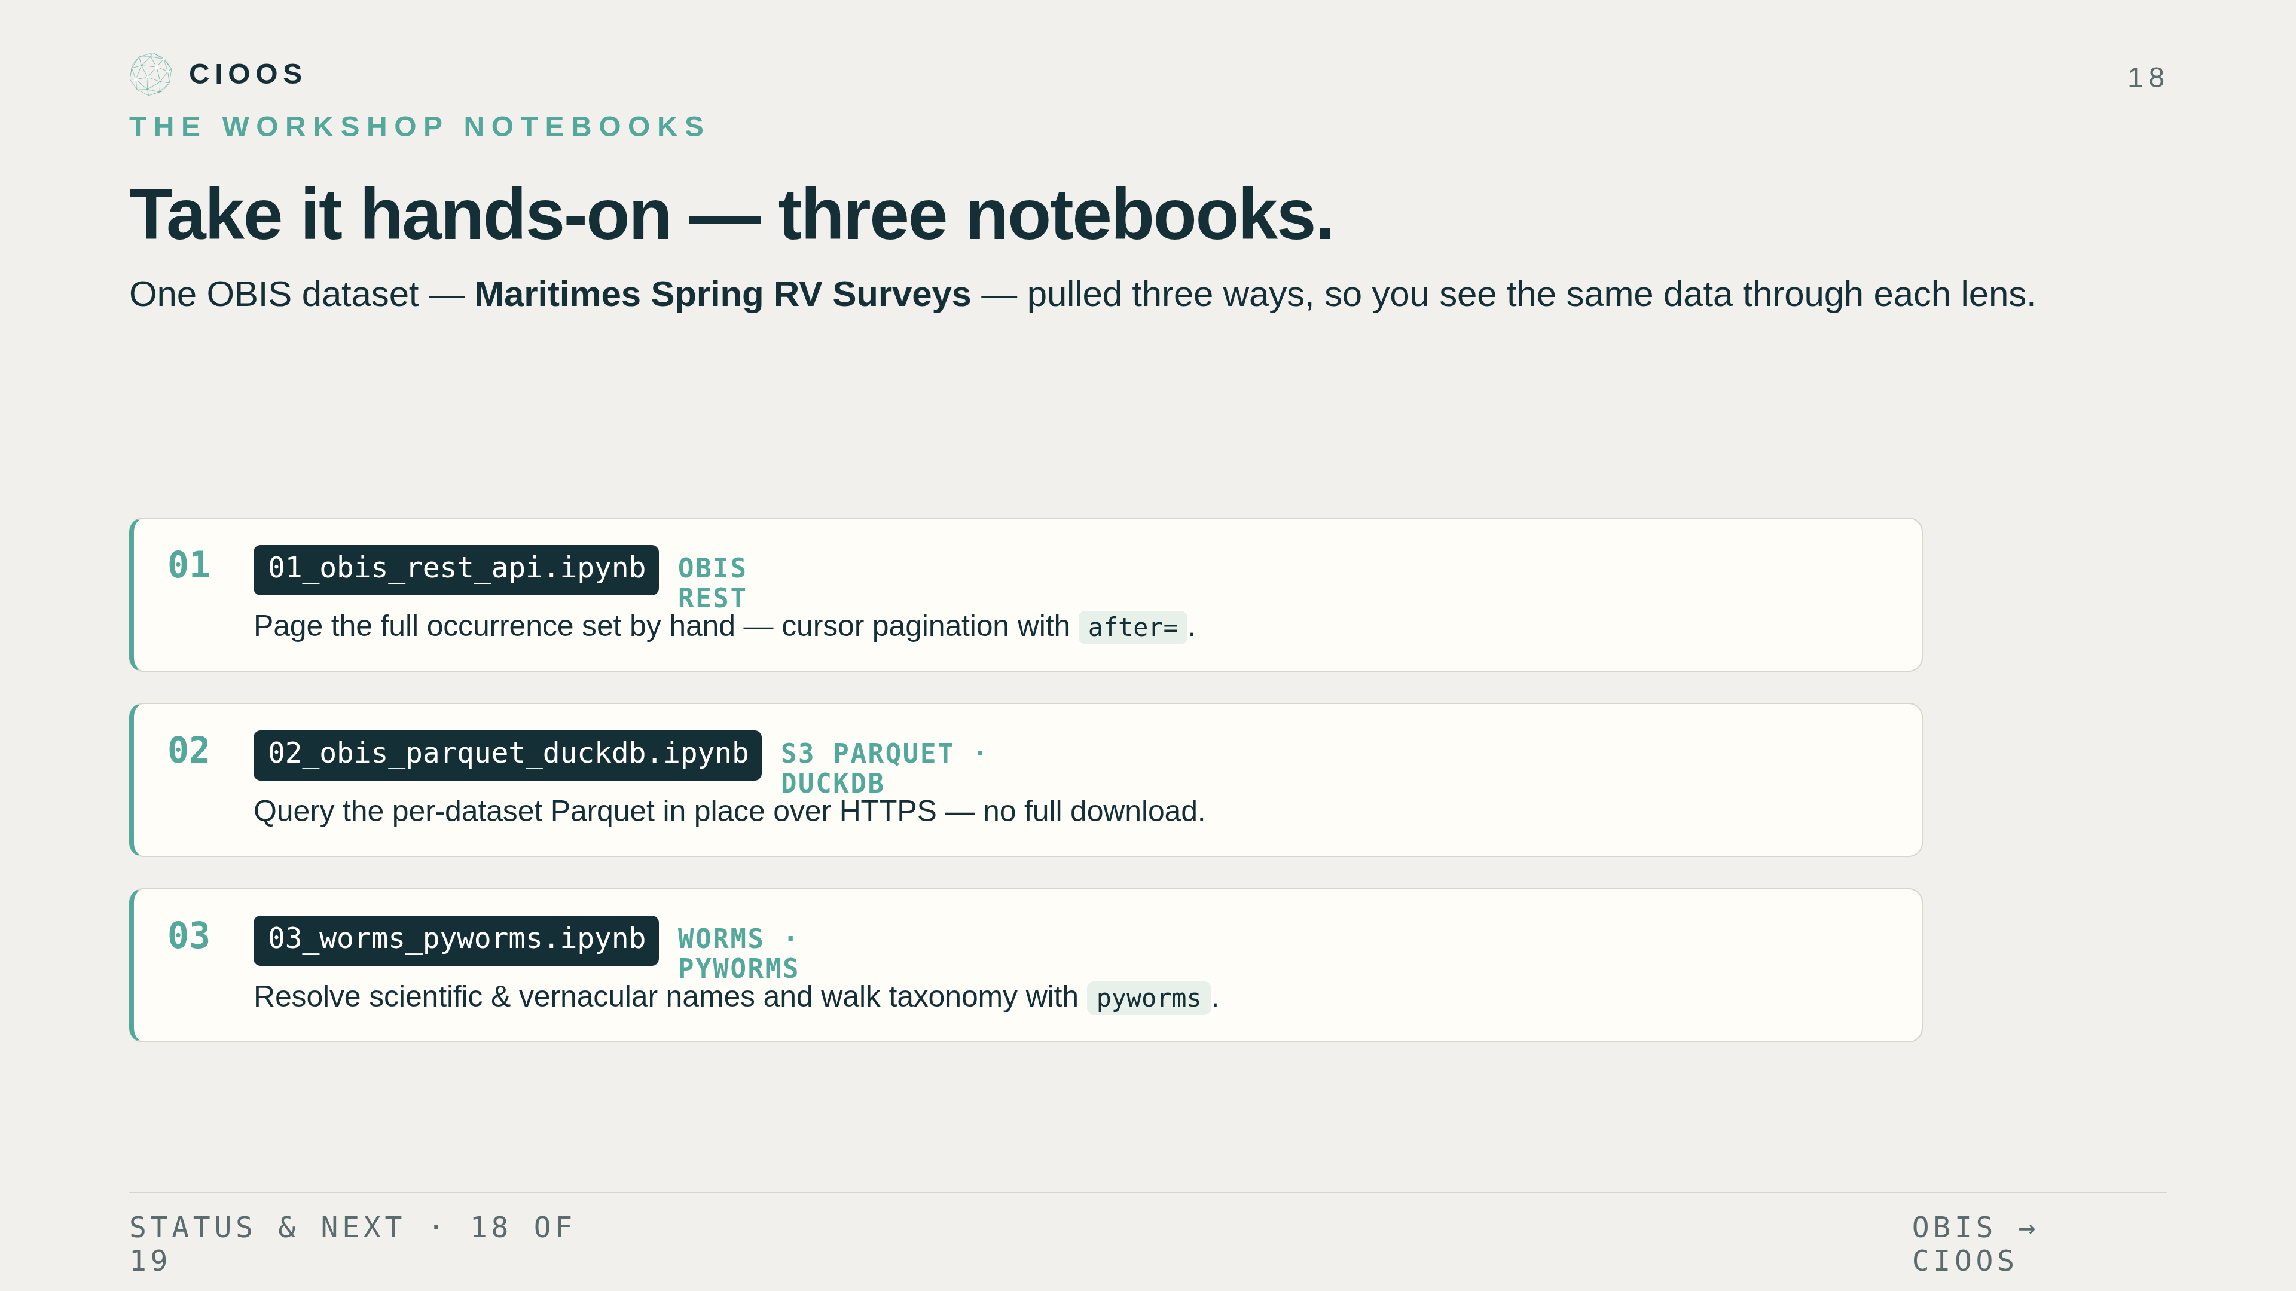
Notes:
The notebooks. Three of them ship with this talk, all running against one OBIS dataset — the Maritimes Spring RV Surveys — so you see the same data three ways. Notebook one pulls occurrences straight from the OBIS REST API with cursor pagination — remember, the cursor is after, not start. Notebook two queries the per-dataset Parquet on S3 in place with DuckDB, no full download. Notebook three resolves scientific and vernacular names and walks the taxonomy with WoRMS through pyworms. Briefly on where the integration itself goes next: it's shipping now for our current harvest config — Maritimes RV, OBIS-Canada core, OTN, and a EurOBIS starter set — and the near-term roadmap is a CKAN bulk-update job to keep the catalogue fresh plus OBIS-API change-detection to trigger re-harvests. But the main event from here is the hands-on session — and because it comes after the other two talks, all of us will be there to help.

Slide 19
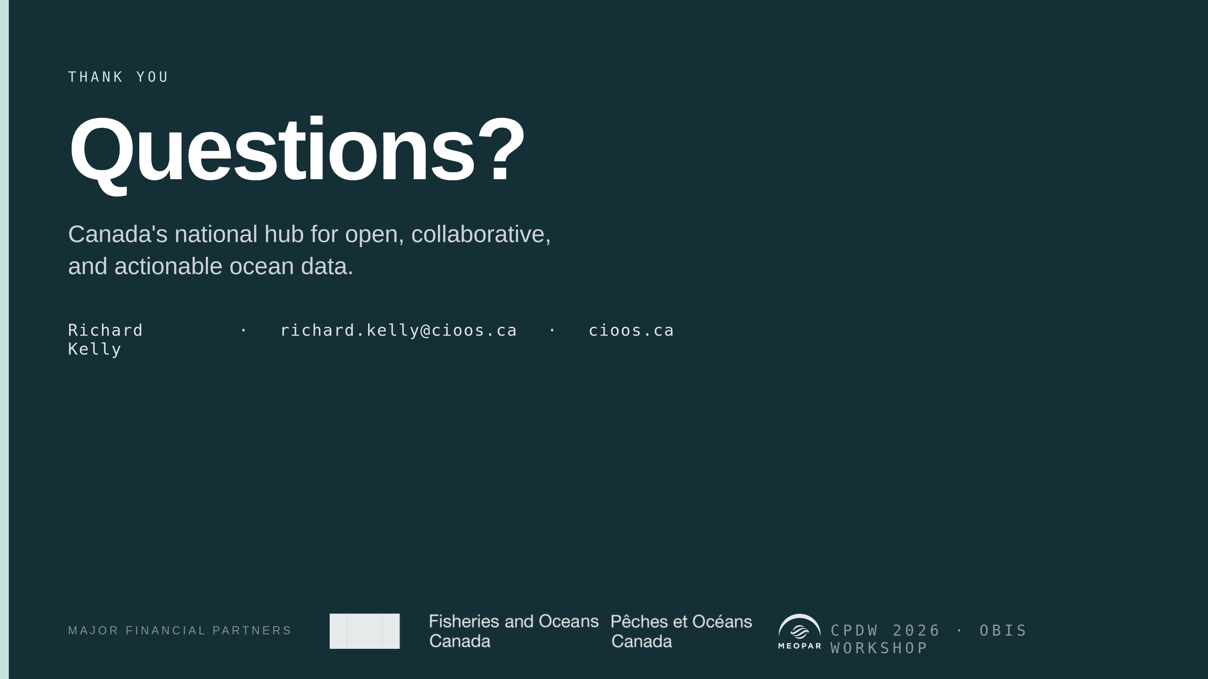
Notes:
Thanks. I'll be around for the notebook session and after. If you're building a new OBIS consumer at CIOOS in the next few weeks please loop me in before you start — there's a good chance one of these pipelines covers what you need.

